Slide 1
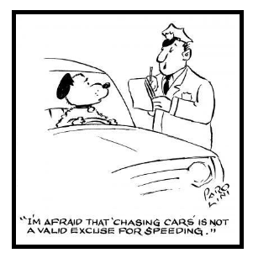
Chase Problems
Involve objects either approaching or chasing each other
E.g. A police car chasing a speeding car.
A passenger chasing a departing train
Two trains heading towards each other on a single track

Slide 2
Key Concepts:
Two objects will be in motion
  Either motion may be uniform or accelerated.
  The objects may be initially separated by a “gap” in distance.
The Starting Point is Two Equations with Two Unknowns
  Find the POI (Point of Intersection) using Grade 10 Math
Solve the chase equations graphically
  Find the intersection point of the position-time graphs.
Solve the equations algebraically
  Using elimination or substitution
Position
5x + 3y = 11
2x – 3y = 3
7x = 14
x = 2
POI
Time

Slide 3
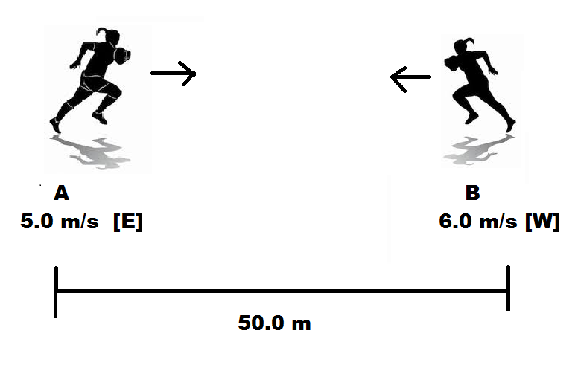
Chase Problem: Minds On!!
Two rugby players separated by 50.0 m begin running towards each other. If neither changes direction or speed, where will they collide?
Answer: Δt =4.55s,
Δd= 22.7 m [E] from A OR 27.3 m [W] from B

Slide 4
Warm-Up #1
Runner “A” starts at the origin and moves at a constant velocity of 10 m/s [E]. Runner “B” starts with a head start of 10 m [E] and moves at a constant velocity of 5 m/s [E]. When and where will runner “A” overtake runner “B”?
Hint: Remember POI and systems of equations from grade 10 math.
Solve the problem graphically using a P-T Graph.
Solve the system mathematically.

Slide 5
Warm-Up #2
A jogger with a constant velocity of 4.50 meters/second runs by a stationary dog. After 1.00 second, the dog decides to chase the jogger. The dog accelerates at 1.50 m/s².
How much time does it take the dog to catch the jogger?
How far away from the spot where the dog was sitting has the jogger gone when she is caught by the dog?
Note: Assume the jogger is listening to her iPod and doesn't realize the dog is chasing her until it's too late. In other words, assume constant velocity for the jogger.
Hint: Do your remember the “quadratic formula”?

